Slide 1
Household Energy End Use Project (HEEP2)
Data on energy use and indoor conditions from a nationally representative sample of households
Led by BRANZ, funded by the Building Research Levy
Households recruited from the Stats NZ Household Economic Survey

Slide 2
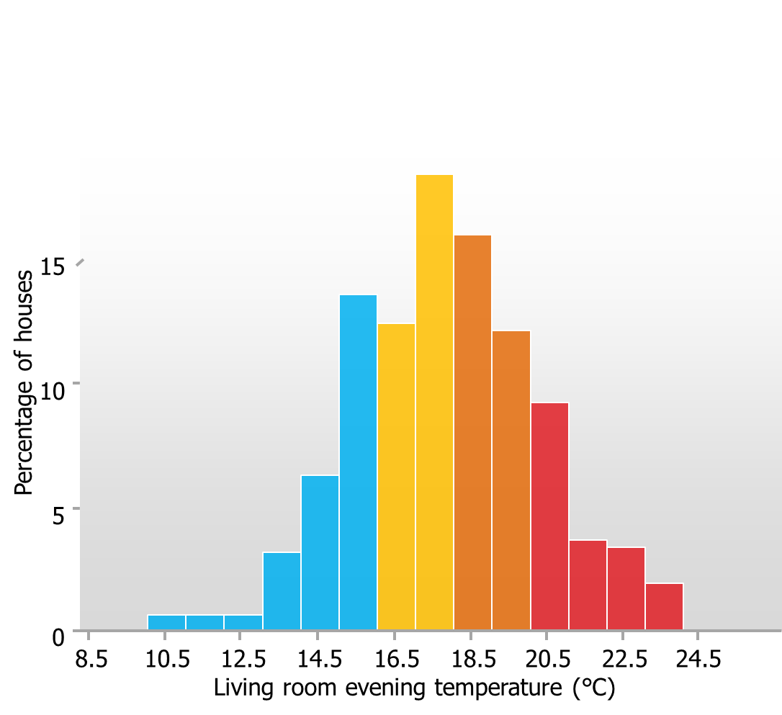
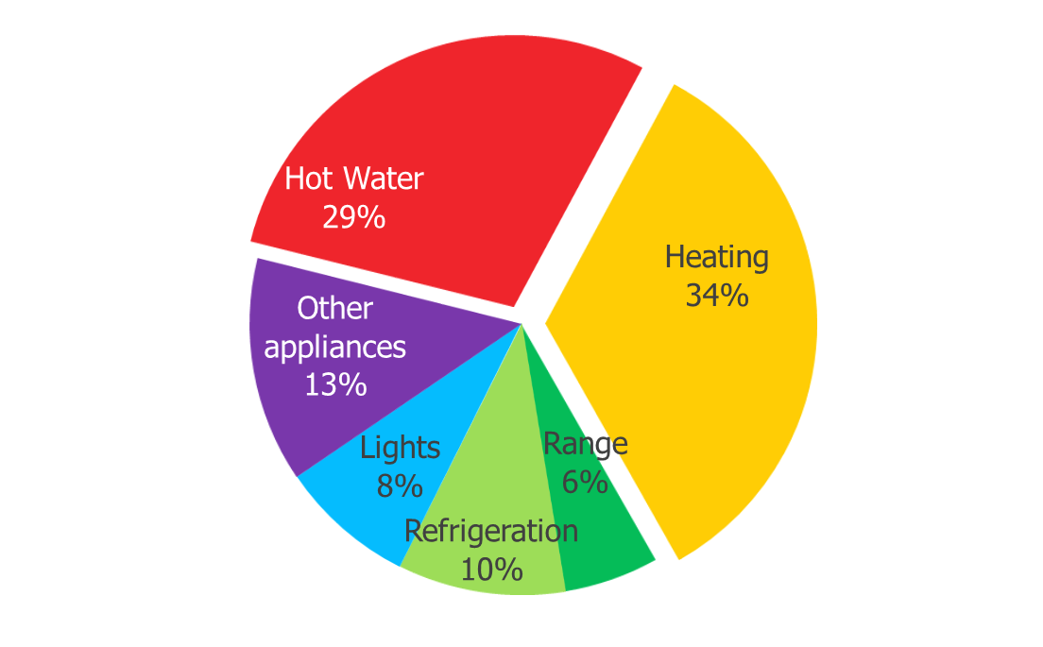
What is HEEP2 and why are we doing it?
An updated picture of energy use in NZ households
Original Household Energy End Use Project (1996-2010)
To enable/motivate people to affordably create healthy home environments in ways that contribute to a low-emissions economy

Slide 3






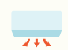


HOT WATER usage ESTIMATED using input energy and temperatures
TEMPERATURE
HUMIDITY
CO₂
in LIVING AND BEDROOMS
OUTDOOR WEATHER
Conditions
Electricity measured CIRCUIT LEVEL at one minute intervals.
Supplementary APPLIANCE METERS
A BUILDING SURVEY to calculate energy DEMAND
An APPLIANCE AUDIT
Measurement of SHOWER FLOW rates INTERVIEW/SURVEY to understand attitudes to energy use
Delivered heat ESTIMATED using extra temperature measurements
and MODEL BUILDING data
GAS flow measured for TOTAL and HOT WATER usage

Slide 4

Wider methodology
Demographics
Dwelling
Health
Household Expenditure
Material Wellbeing
Housing Condition
First installs
September 2021
Household Economic Survey (n=3500)
12 months of monitoring
HEEP2 light
(n=800)
Last uninstall
September 2023
HES + Smart Meter Data + Short Survey
HEEP2 medium
(n=600)
Data available in the Data Lab
HES + Smart Meter Data + Full Survey + Building Audit
HEEP2 Full
(n=280)
HES + Smart Meter Data + Full Survey + Building Audit + Full Instrumentation
For more info
branz.co.nz/heep2
Greg.overton@branz.co.nz

